Slide 1





PRESENTATION 2026
Student Name
Student Email
Akita kamble
ankitakamble2728@gmail.com
Mentor Name
Guide Name

Slide 2

Outline
Abstract of the Project
Problem Statement
Proposed Solution
System Architecture
Live Demo of the Project
Embedded Video of Project
Conclusion
Future Scope

Slide 3
Abstract
HR dataset with 500 records and 16 attributes analyzed.
Data cleaned using Excel.
Insights visualized using Power BI dashboards.
Focus on attrition, salary, and performance.
AI tools used for quick insights.

Slide 4

Problem Statement
HR data is large and unstructured
Difficult to analyze manually
Hard to identify attrition & performance
trends Need for data-driven decision system

Slide 5

Proposed Solution
[Clean data using Excel
Analyze using Power BI
Create interactive dashboards
Use AI tools for insights

Slide 6
System Architecture
Data Input / Source
Processing / Analysis
Input: HR dataset (500×16)
Processing: Data cleaning & analysis
AI / Tool Integration
Output / Dashboard
Visualization: Power BI dashboards AI Layer: ChatGPT / Copilot
Output: Insights & reports dashboard

Slide 7
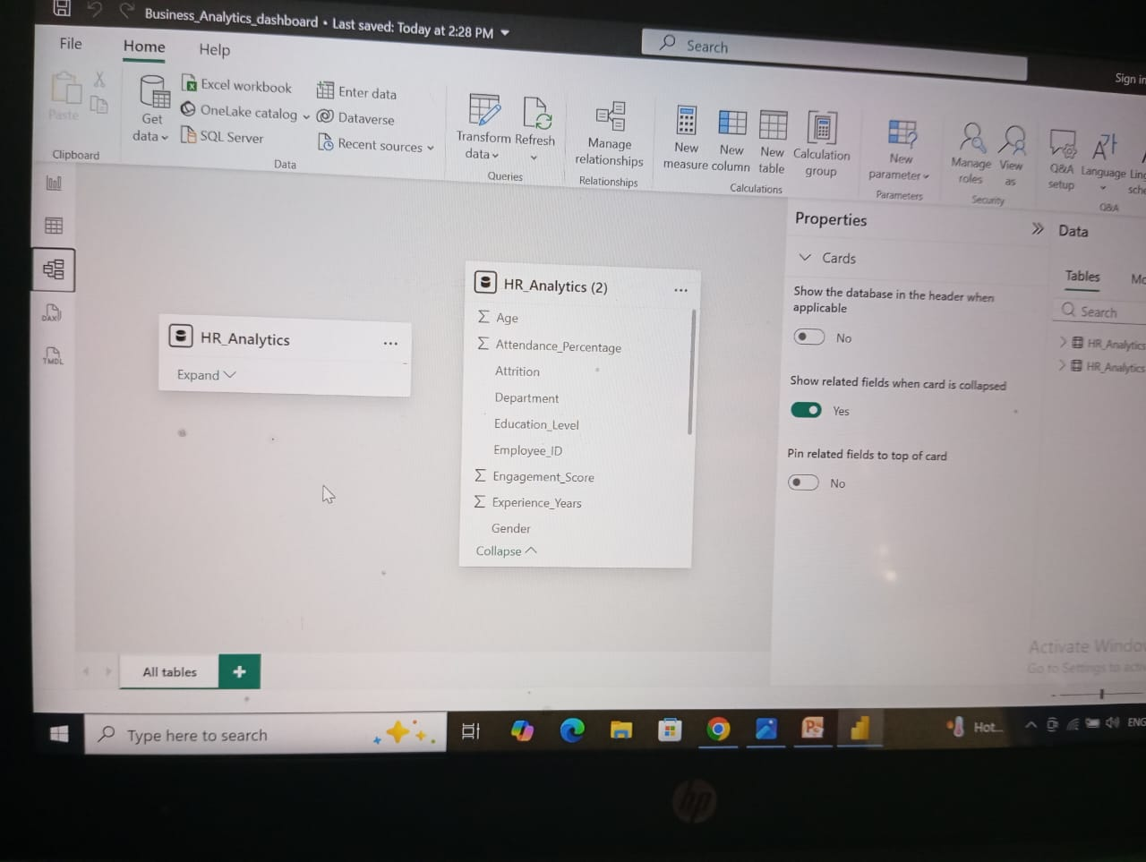
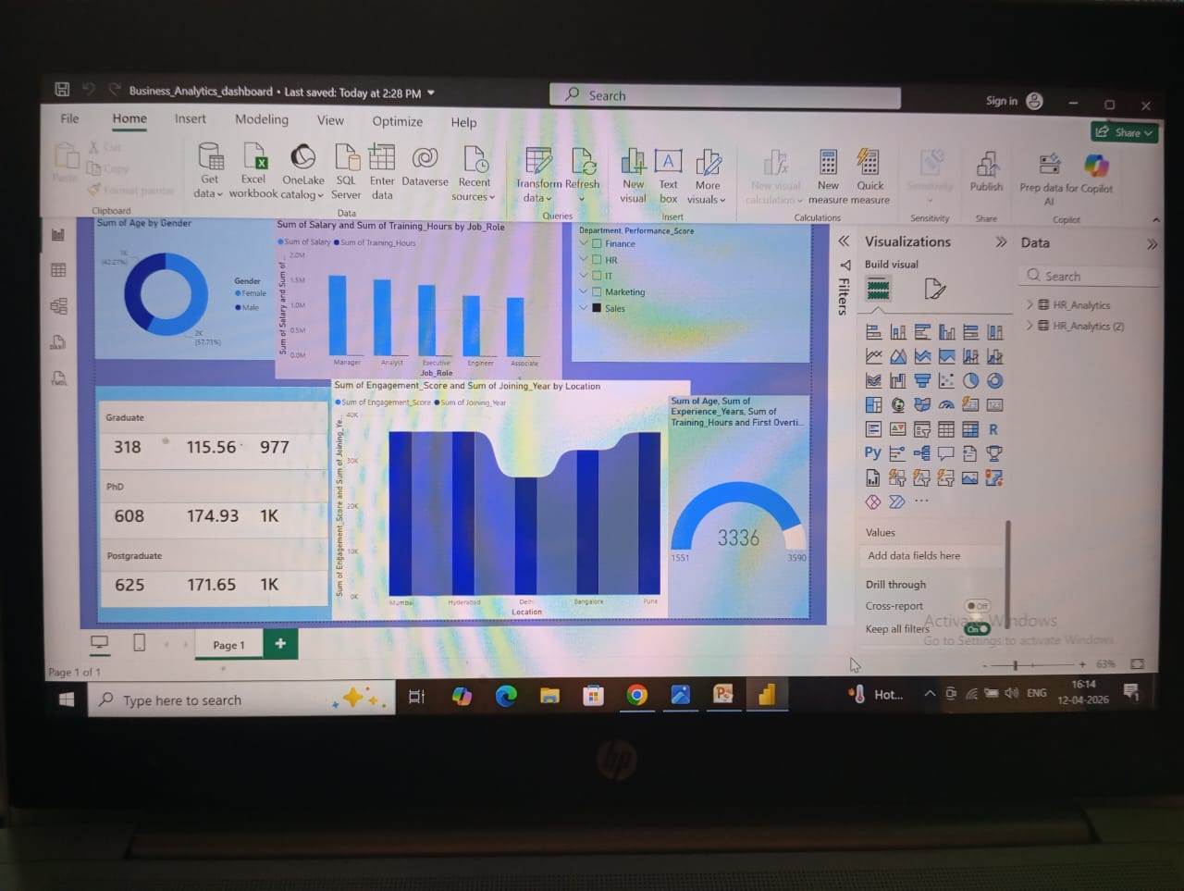
Live Demo of Project
Here's the list of some demo screenshots / features of the project:
Demo 1
Demo 2
Demo 3
[

Slide 8
Video of Project Demo
[https://your-project-demo-link.com]
▶
[Insert your project demo video.
You can embed a video your live project.]

Slide 9

Conclusion
Converted raw data into useful insights
Identified attrition & performance trends
Improved decision-making
Demonstrates importance of Business Analytics
CONCLUSION

Slide 10

Future Scope
Add predictive analytics
Use real-time data
Build advanced dashboards
Develop web/app system

Slide 11
Thank You
AICW Fellowship | Student Project Presentation 2026
LinkedIn | Edunet Foundation

